Slide 1

C-ITS Anonymous Attestation on Blockchain
A privacy-preserving architecture for Cooperative Intelligent Transport Systems using Ethereum Smart Contracts.
Feridun Tavşanlı (Student ID: 210304006)

Slide 2

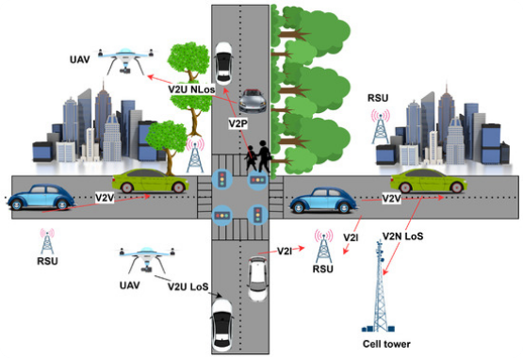
Project Goal & Objectives
The primary goal is to implement a blockchain-based anonymous attestation mechanism for C-ITS environments, modeling a simplified PKI-based trust architecture.
•
Anonymous Identity: Vehicles use pseudonyms instead of real identities to preserve privacy.
•
Authority Validation: Certificate-based authority validation ensures only registered RSUs operate.
•
Trust-based Messages: Secure V2X message attestation on-chain.
•
Security Controls: Built-in revocation and expiry-based control systems.

Slide 3


System Architecture Contracts
Certification Authority (CA)
Anonymous Attestation
The core administrative smart contract responsible for managing network trust and institutional actors.
The operational contract interacting directly with vehicle nodes to ensure secure, anonymous communication.
•
Registering Road Side Unit (RSU) and authority nodes.
•
Vehicle pseudonym management and uniqueness verification.
•
Issuing verifiable digital certificates.
•
Attestation creation for V2X broadcasts.
•
Validating authority permissions strictly on-chain.
•
Trust record storage, verification logic, and revocation checks.

Slide 4
Operational Workflow
4. Verification
2. Issuance
Any network user can verify message authenticity, validity, and expiry.
Authorities issue valid blockchain certificates for V2X authentication.
1. Registration
3. Attestation
Admin securely registers RSU authorities in the central system.
Vehicles anonymously submit V2X messages utilizing their pseudonyms.

Slide 5






V2X Message Composition
Pseudonym
Authentication
Payload Data
Vehicles utilize a unique `pseudonymVehicleId` rather than a static MAC or VIN, ensuring complete route anonymity.
Messages include a `certificateId` and a cryptographic `signature` to prove institutional backing without revealing identity.
Contains the actual `messageType` (e.g., CAM), `messageData` (e.g., speed), and strict timestamp bounds.

Slide 6

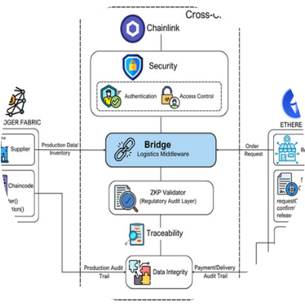
Testing Environment Setup
Solidity & Web3 Infrastructure
The entire anonymous attestation prototype is built and verified utilizing standard Ethereum development tools.
We deploy standard Smart Contracts utilizing Solidity version ^0.5.16. The testing sequence is executed within the Remix IDE environment, leveraging the built-in JavaScript VM and Injected Web3 for transactional simulation.

Slide 7
Core Validation Scenarios
Test Scenario | Function Executed | Expected Result | Status
Authority Registration | registerRSU(...) | RSU successfully registered; authority becomes valid. | Pass
Credential Issuance | issueAttestationCredential(...) | Credential marked valid; restricted to CA only. | Pass
Attestation Creation | createAttestation(...) | Attestation stored on-chain; Pseudonym marked used. | Pass
Attestation Verification | verifyAttestation(...) | Returns true; displays valid RSU data and message. | Pass

Slide 8
Security & Edge Case Testing
Duplicate Pseudonyms (Replay Protection): Transactions revert with "Pseudonym already used" if a vehicle attempts to reuse an ID, ensuring strict replay protection.
Expired Attestations: Verification fails automatically with an "Certificate expired" error if the current timestamp exceeds the specified expiry time.
Unauthorized Actions: Only registered RSUs can issue credentials; attempts by unknown nodes revert immediately with "RSU not authorized".
Revocation Handling: Attestations can be permanently marked as revoked by authorities, neutralizing compromised credentials network-wide.

Slide 9

System Security Model
Our architecture ensures robust protection through multiple layers. Pseudonym-based anonymity completely masks true vehicle identities, while certificate validation guarantees institutional authenticity.
Furthermore, strict expiry time checks and unique pseudonym tracking prevent replay attacks and malicious data reuse. A swift revocation mechanism neutralizes compromised nodes instantly.

Slide 10


Current Limitations
Technical Constraints
Scope Constraints
While the logic is sound, certain real-world implementations are abstracted for this prototype:
The system is designed as an academic proof-of-concept rather than production-ready software.
•
No ECDSA Verification: True cryptographic signature verification is currently not implemented on-chain to save gas costs.
•
Prototype Level: Represents a baseline implementation for academic demonstration.
•
Simplified Security: Models a simplified C-ITS security architecture, omitting complex cross-border PKI root exchanges.
•
No V2X Simulation: Operates without a simulated hardware network (e.g., physical DSRC/C-V2X radios).

Slide 11
Reference: Certoshi Comparison
Feature Specification | Certoshi System | This Project (C-ITS)
Application Domain | Digital Certificates (Education/Corp) | C-ITS Vehicular Systems (V2X)
Identity Management | Institutional / Real Identity | Pseudonym-based Vehicles
Privacy Focus | Low (Transparency first) | High (Anonymous Attestation)
Blockchain Role | Static Certificate Registry | Dynamic Trust & Attestation Layer
While Certoshi focuses on institutional certificates, this project successfully extends the concept into highly-mobile, privacy-critical vehicular networks.

Slide 12
Conclusion
This project successfully demonstrates a blockchain-based anonymous attestation system for C-ITS, focusing on preserving vehicle privacy while ensuring decentralized, trust-based verification.
Feridun Tavşanlı Student ID: 210304006

Slide 13



Image Sources
https://www.mdpi.com/electronics/electronics-15-01042/article_deploy/html/images/electronics-15-01042-g002-550.jpg
Source: www.mdpi.com
https://www.mdpi.com/computers/computers-15-00198/article_deploy/html/images/computers-15-00198-g006-550.jpg
Source: www.mdpi.com
https://png.pngtree.com/png-clipart/20250417/original/pngtree-cybersecurity-concept-with-a-glowing-lock-symbol-on-digital-background-png-image_20714179.png
Source: pngtree.com

